Slide 1
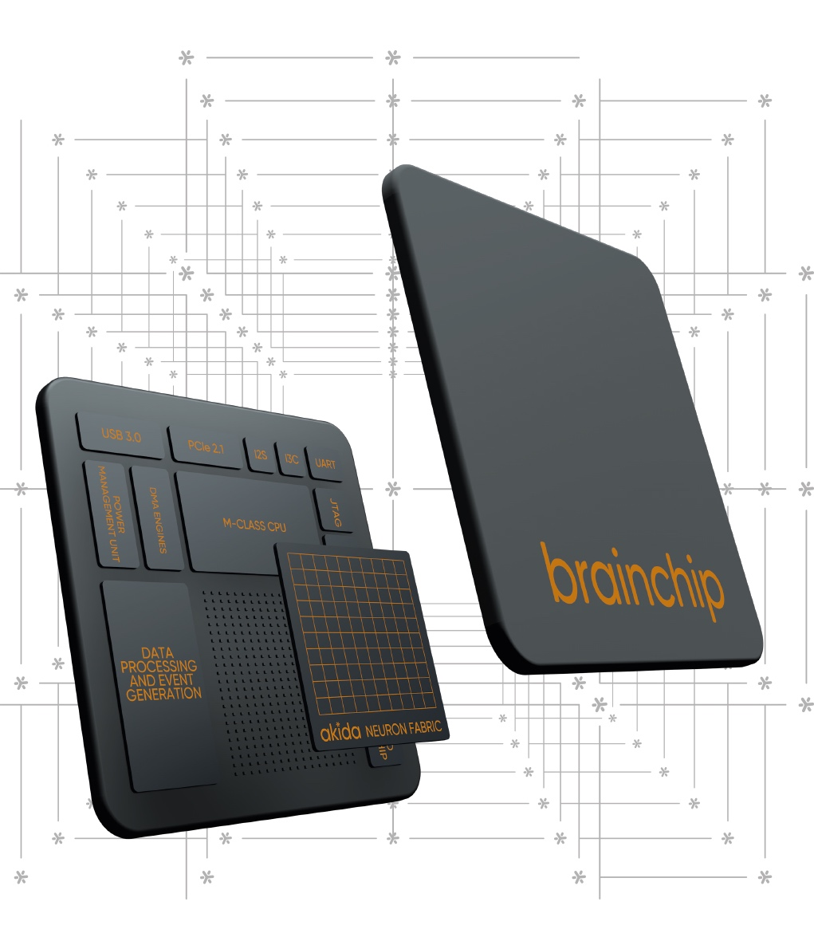
Flow Machines and Neuromorphic Devices
M Anthony Lewis, Ph.D.
Chief Technology Officer
BrainChip, Inc. (BRN.AX)

Slide 2
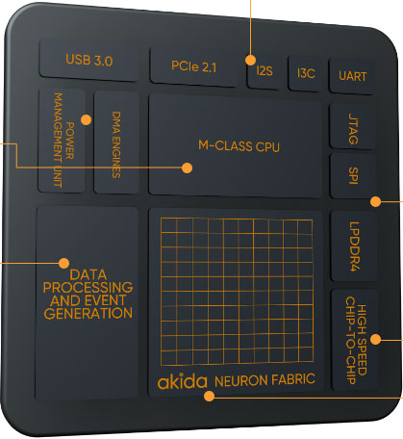

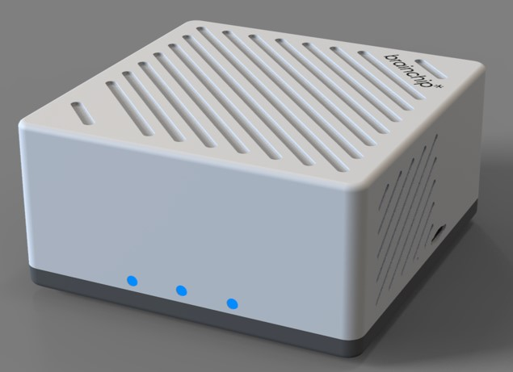
















Brainchip AI – At a Glance
  First to commercialize neuromorphic IP platform and reference chip.
  15+ yrs fundamental research
  65+ data science, hardware & software engineers
  Publicly traded Austrialian Stock Exchange (BRD:ASX)
  Customers – Early Access, Proof of Concept, IP License. Including space and aerospace.
PRODUCTS
IP
Reference SoC
Software Tools
Edge Box*
TRUSTED BY
PARTNERS
*Fulfillment through VVDN technologies
©2024 BrainChip Inc. Confidential

Slide 3
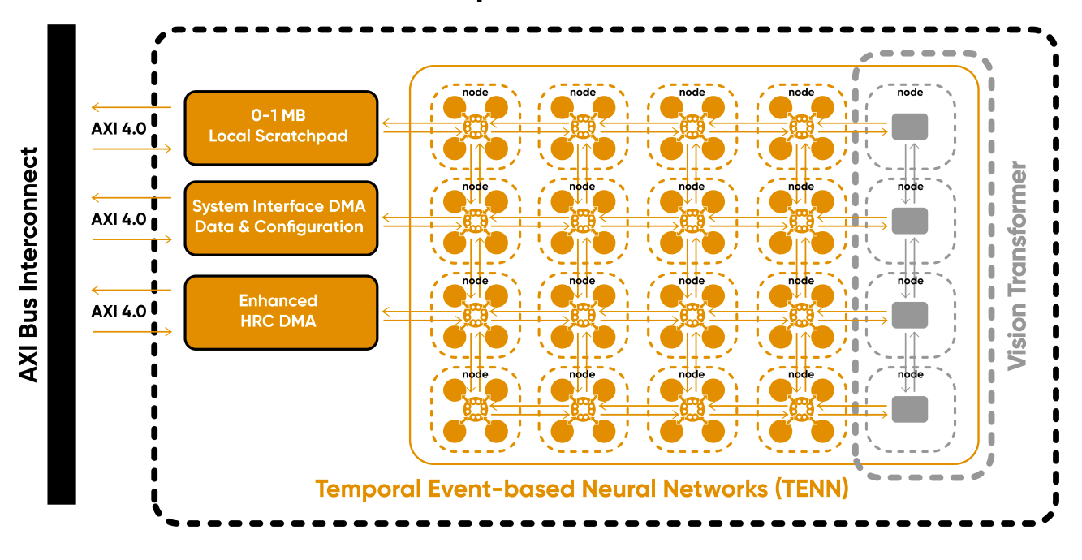

Akida 2.x IP: Architecture and Benefits
Key hardware Features
Digi
Digital, Event-Based, at memory compute
Weighted Spikes.
Highly Scalable
Each Node connected by mesh network
Event-based TENN processing units in each node
Execution independent of CPU, unlike DLA
Delivered as RTL
BRAINCHIP | TENN
Notes:
Spatial-Temporal Convolutions enable innovative handling of 3D and 1D data
Enables advanced video analytics and predictive analysis of raw time series data
Better accuracy at the edge while substantially reducing model size and footprint
Skip Connections:
https://www.youtube.com/watch?v=Q1JCrG1bJ-A
Can Add or Concatenate to combine tensors
Advantages:
Each block augments the data
Simpler to learn, betters the information
Shorter gradient paths
Faster training
Modularity
Easy to add blocks
Vision Transformers:
Vision Transformer: What It Is & How It Works [2023 Guide] (v7labs.com)
Vision Transformers (ViT) are state-of-the-art in computer vision and widely used for different image recognition tasks. ViT models outperform the current state-of-the-art CNNs by almost four times in terms of computational efficiency and accuracy.
Key Idea: self-attention encoder/decoder blocks
Spatial:
Neural Networks For Spatial Data – Surfactants
Spatial data is used to describe a physical object or the physical location of data.
Spatial information refers to the location and orientation of objects in space.
Temporal:
A Temporal Neural Network Architecture for Online Learning (researchgate.net)
Temporal neural networks (TNNs) are SNNs that communicate and process information encoded as relative spike times (in contrast to spike rates).

Slide 4
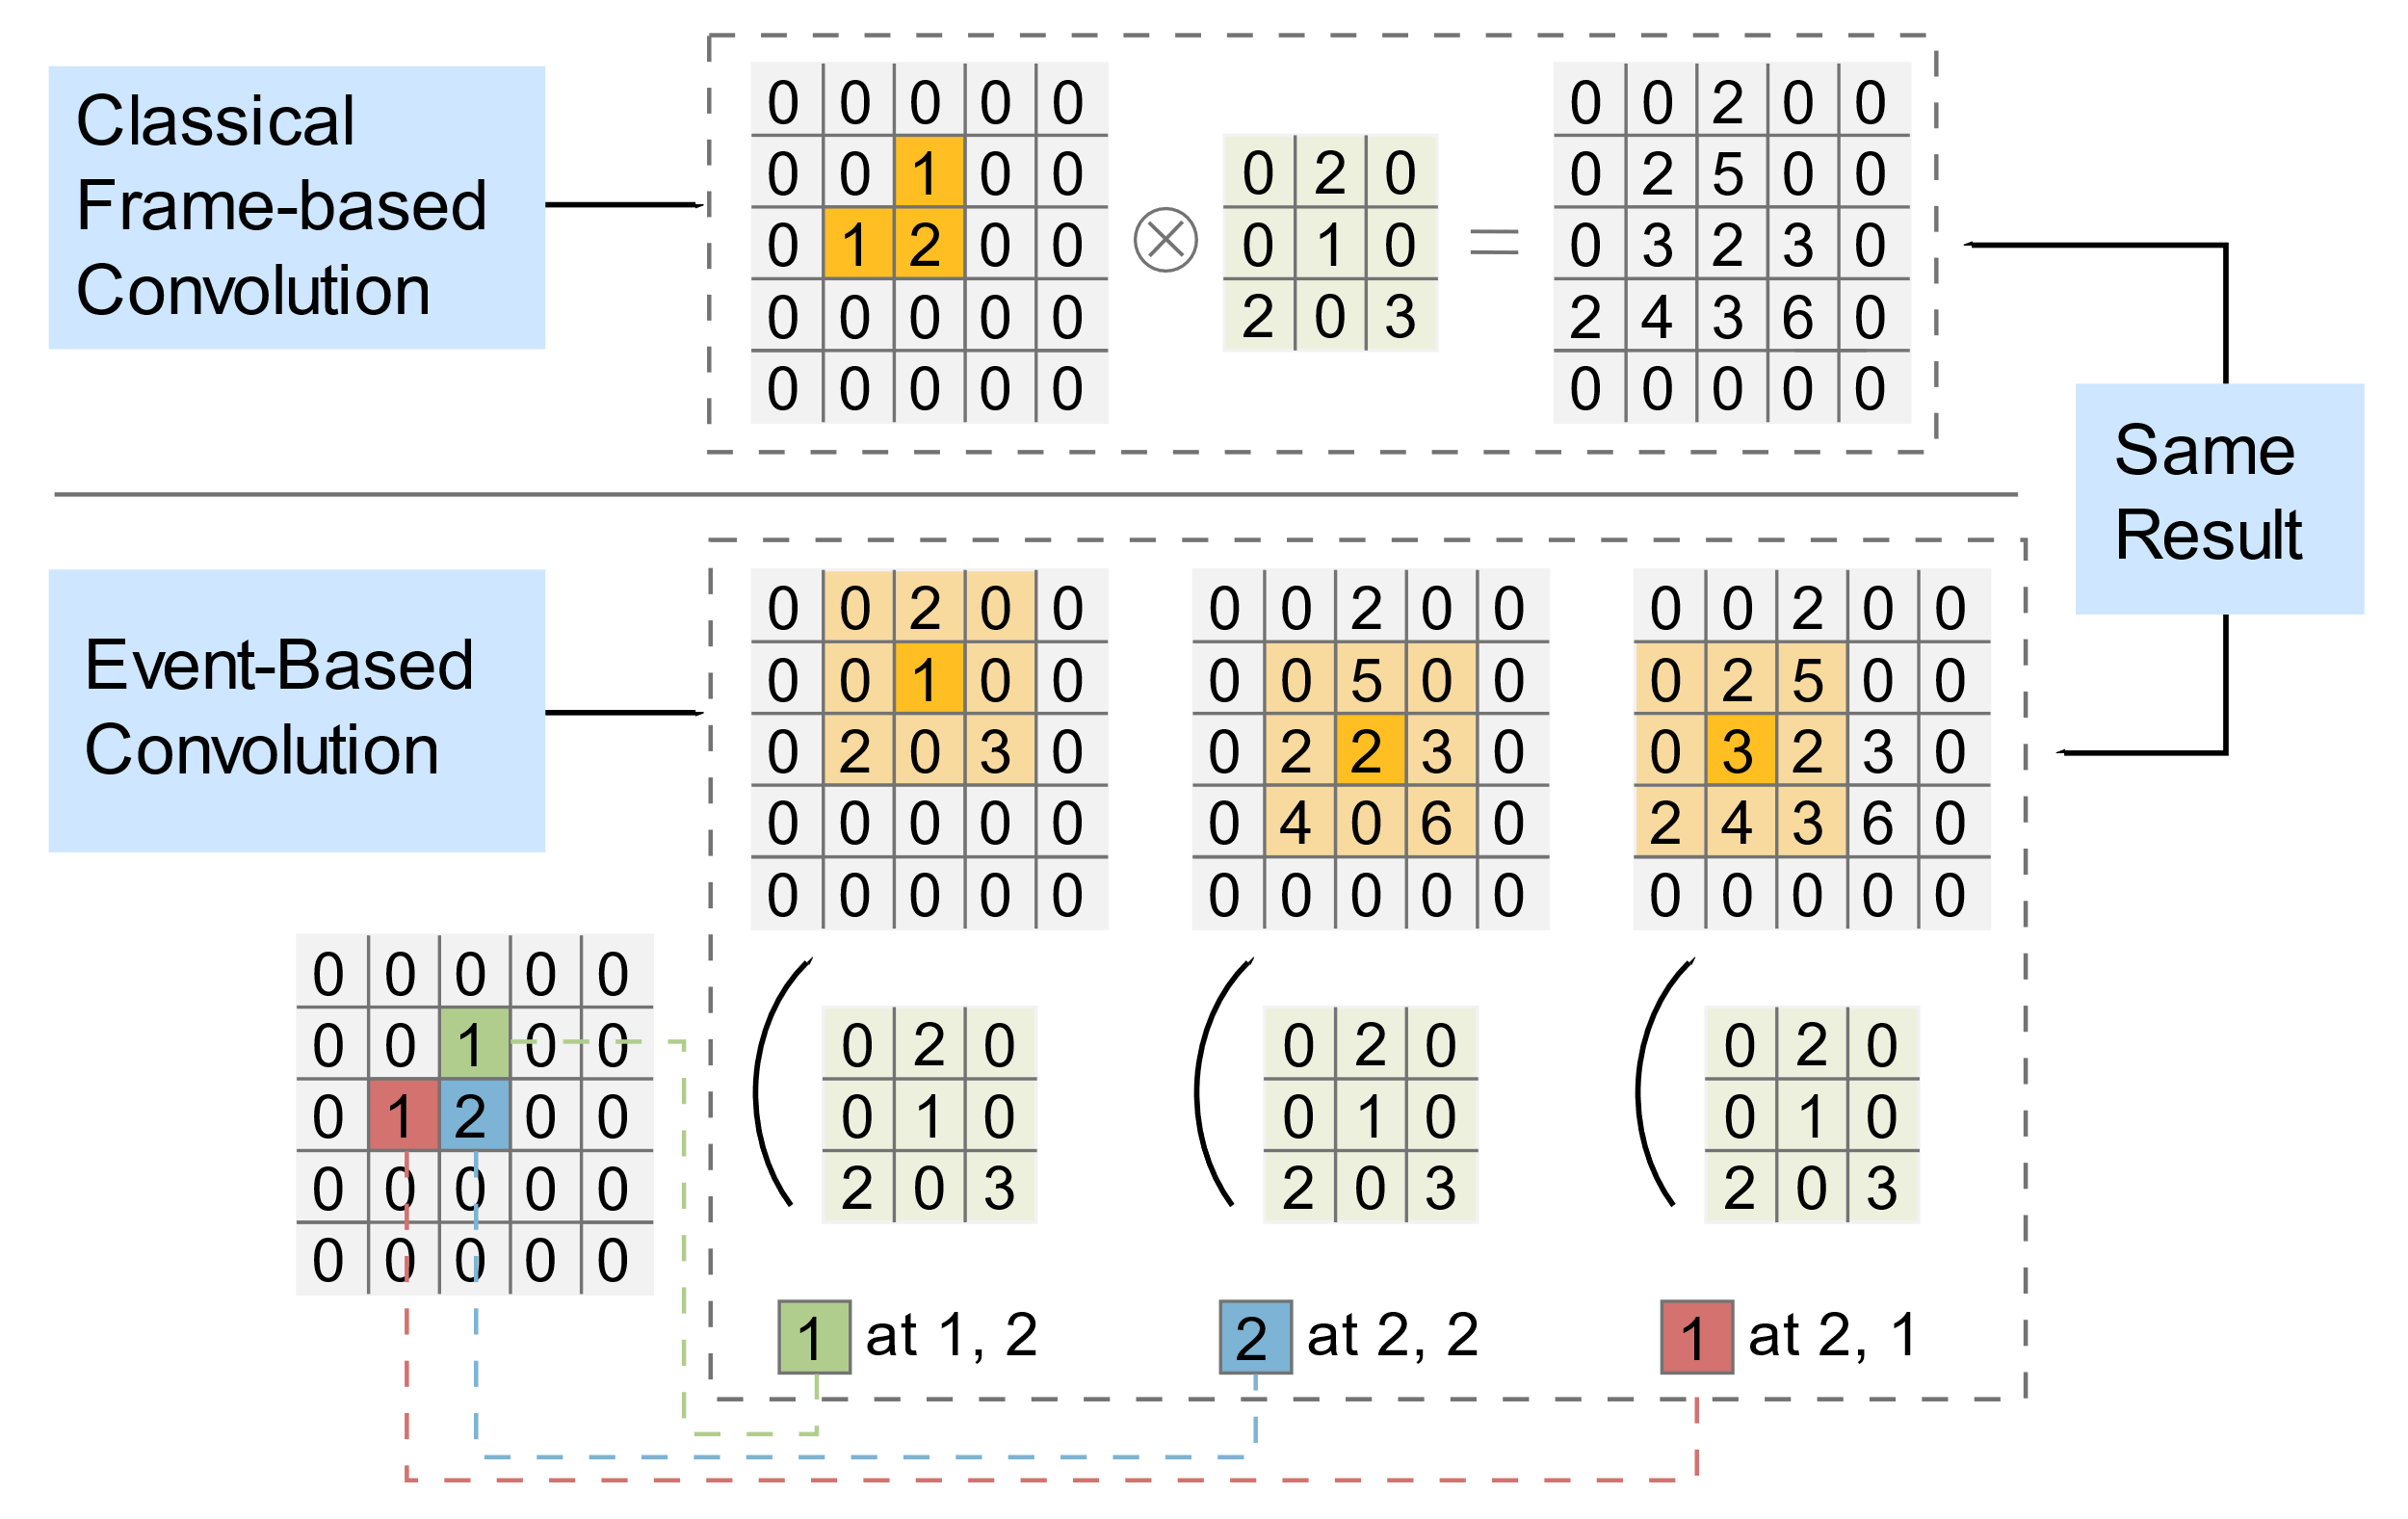


Event-Based Convolution, 2-D example
Benefits from Activation Sparsity
$$9×5×5=225 \text{MACs}$$
$$9×3=27 \text{MACs}$$
BRAINCHIP | TENN

Slide 5
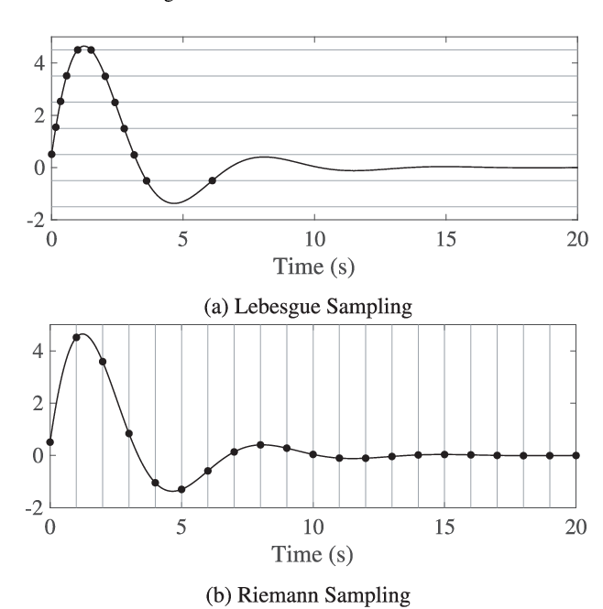
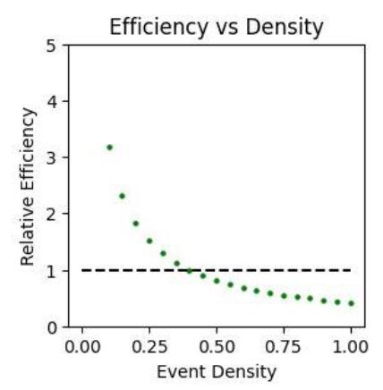
Simple example of Event processing and benefits
Lebesgue Sampling
Greater that 100% mac efficiency
When relative efficiency passes one, we see mac performance that exceed the “theoretical max”
T. Kawaguchi, M. Inoue, S. Adachi, 2017, State Estimation under Lebesgue Sampling and an Approach to Event-Triggered Control

Slide 6
What Matters
Algorithms
Software
MACs
Size
Data

Slide 7
Flow machines: Long sequence processing makes use of sparse data representation
Edge AI
No State memory
Static image recognition (resnet-50)
LSTMs on Frames
Leverage State Memory
Neuromorphic
Animals
Long context State space models
TENNS
Mamba/S5
Transformer based LLMs
Modern AI Lives Here
Future Edge AI Lives Here
Leverages redundancy in data
Long state Memory
Dramatically reduces power
Future or edge-AI
Static Machines
Flow Machines
Flow Machine Concept being co-developed with Dr. Jon Tapson, CDO, BrainChip

Slide 8
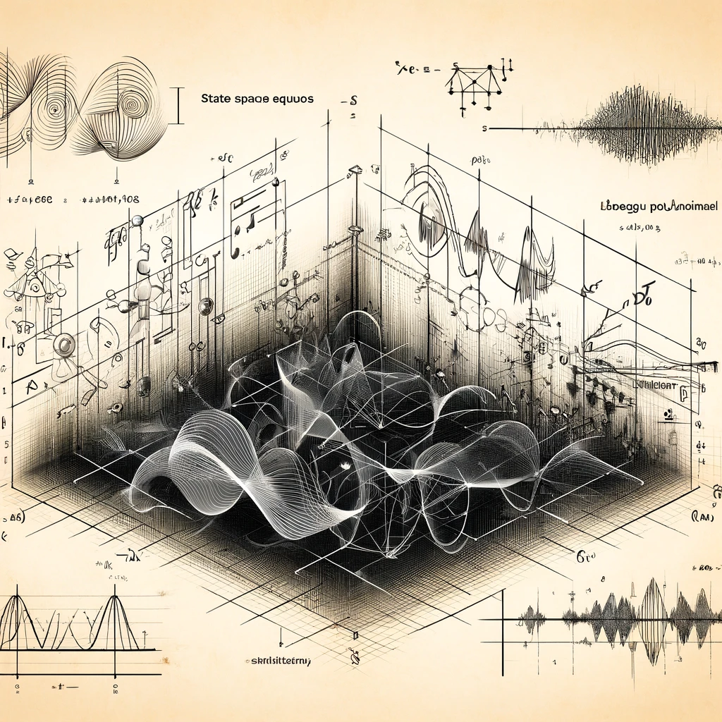
TENNs can reduce energy use by orders of magnitude
TENN = TEMPORAL EVENT-BASED NEURAL NETWORK
TENN is related to State Space Models
Replacement for many Transformer tasks
  Language Models
  Time-series Data
  Spatiotemporal Data
Dramatically lowers energy requirements across all compute platforms
Can Leverage Event Based Computation

Slide 9
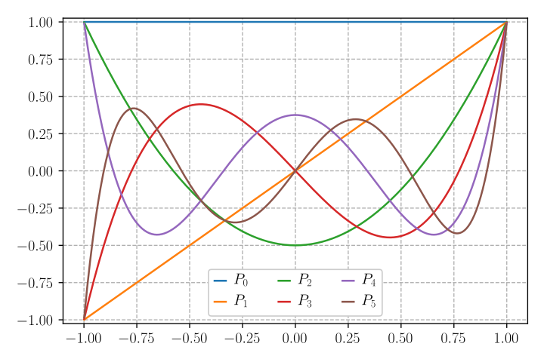
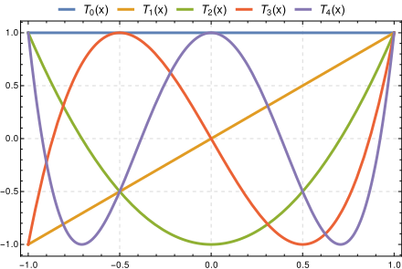


Representing time-series with Recursive 0rthogonal polynomials
Inspiration: Physicists @ brainchip modeling neural dynamics in a compact form
Legendre polynomials
Chebyshev polynomials
ILegendre polynomials basis : exponential convergence for analytic functions.
Not tolerant to discontinuities
Chebyshev polynomial basis can lead to exponential convergence for a wide range of functions, including those with singularities or discontinuities.*
*Lloyd N. Trefethen. 2019. Approximation Theory and Approximation Practice, Extended Edition. SIAM-Society for Industrial and Applied Mathematics, Philadelphia, PA, USA.

Slide 10
Key Insight
Kernal Mode Convolution:
Trains like a CNN
Recursive Mode Convolution:
Runs like an RNN

Slide 11
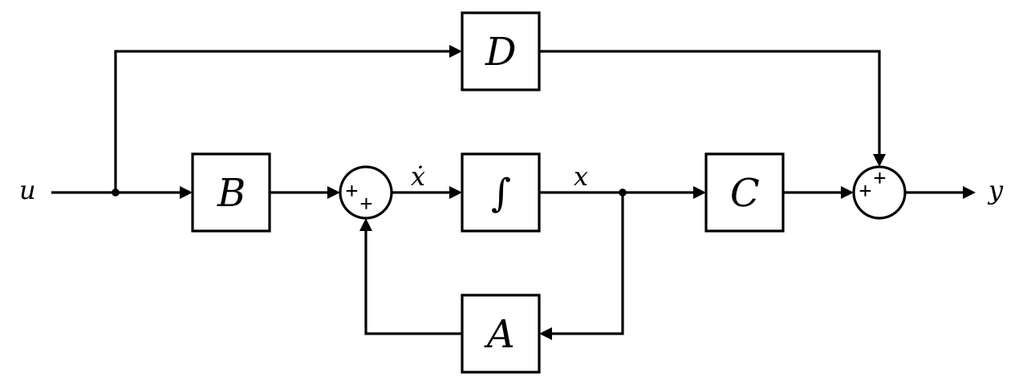

Run mode is a State Machine!
Principles:
Recurrence: Chebyshev and Legendre polynomials have recurrence relationship.
Duality: Recurrence imputes duality: Convolutional form as well as recurrent form.
Stable training: Train in Convolutional Domain
Fast Running: Run in recurrent domain. Small foot-print
Insight: TENNs and SSM are a stack of generalized “Fourier filters” running in a recurrent mode, with non-linearities between layers.
Independently discovered by Albert Gu, Stanford
BrainChip had already designed Hardware to support it
Layer-1
Layer-N
f(y)
$$\dot{x}=Ax+Bu$$
$y=Cx+Du$
$f(y)$

Slide 12
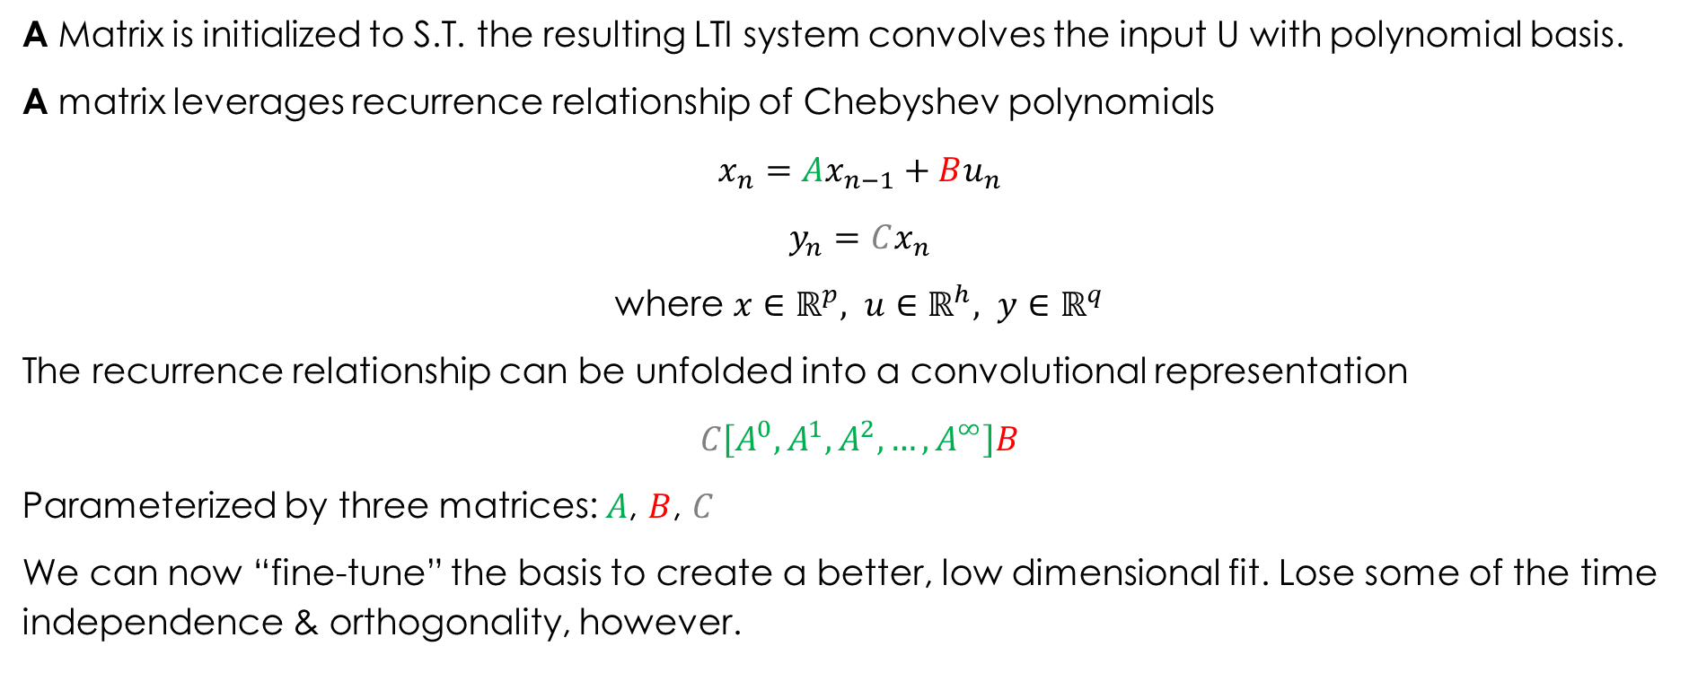
Recurrent to Convolution
Put it all together: recurrence, State space and kernel fine-tunning
A Matrix is initialized to S.T. the resulting LTI system convolves the input U with polynomial basis.
A matrix leverages recurrence relationship of Chebyshev polynomials
  $$x_{n}=Ax_{n−1}+Bu_{n}$$
  $$y_{n}=Cx_{n}$$
  where $x∈ℝ^{p}, u∈ℝ^{h}, y∈ℝ^{q}$
The recurrence relationship can be unfolded into a convolutional representation
  $$C\left[A^{0}, A^{1}, A^{2}, …, A^{∞}\right]B$$
  Parameterized by three matrices: $A$, $B$, $C$
  We can now “fine-tune” the basis to create a better, low dimensional fit. Lose some of the time independence & orthogonality, however.

Slide 13
Recurrent to Convolution
Put it all together: recurrence, State space and kernel fine-tunning
A Matrix is initialized to S.T. the resulting LTI system convolves the input U with polynomial basis.
A matrix leverages recurrence relationship of Chebyshev polynomials
  $$x_{n}=Ax_{n−1}+Bu_{n}$$
  $$y_{n}=Cx_{n}$$
  where $x∈ℝ^{p}, u∈ℝ^{h}, y∈ℝ^{q}$
The recurrence relationship can be unfolded into a convolutional representation
  $$C\left[A^{0}, A^{1}, A^{2}, …, A^{∞}\right]B$$
  Parameterized by three matrices: $A$, $B$, $C$
  We can now “fine-tune” the basis to create a better, low dimensional fit. Lose some of the time independence & orthogonality, however.
Note Compactness
Note redundancy

Slide 14
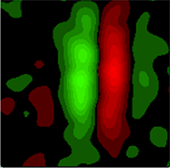
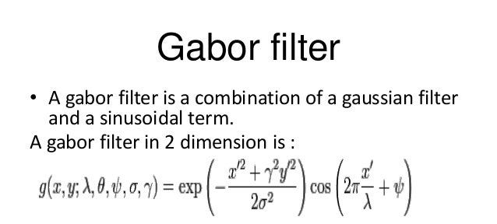
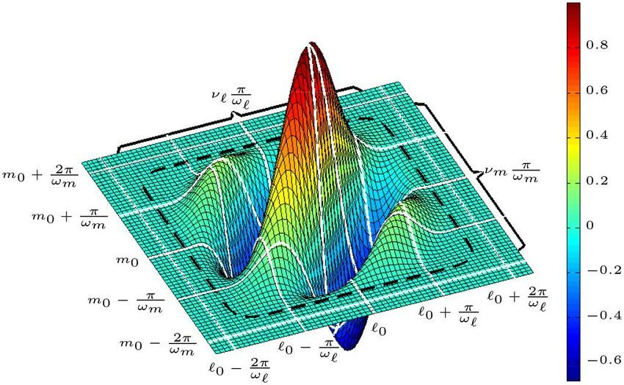
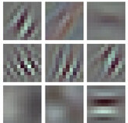
Kernel Representation Evolution
The journey from neurons to polynomials
Receptive Field of a simple cell
DeAngelis et al., 1995)
Receptive Field of V1 Hubel & Wiesel, 1959, 1962
Gabor filter: continuous parametric models of receptive fields
Popular in the 1990s.
Replaced by learnable kernels in deep learning.
Brachmann & Redies
2016

Slide 15
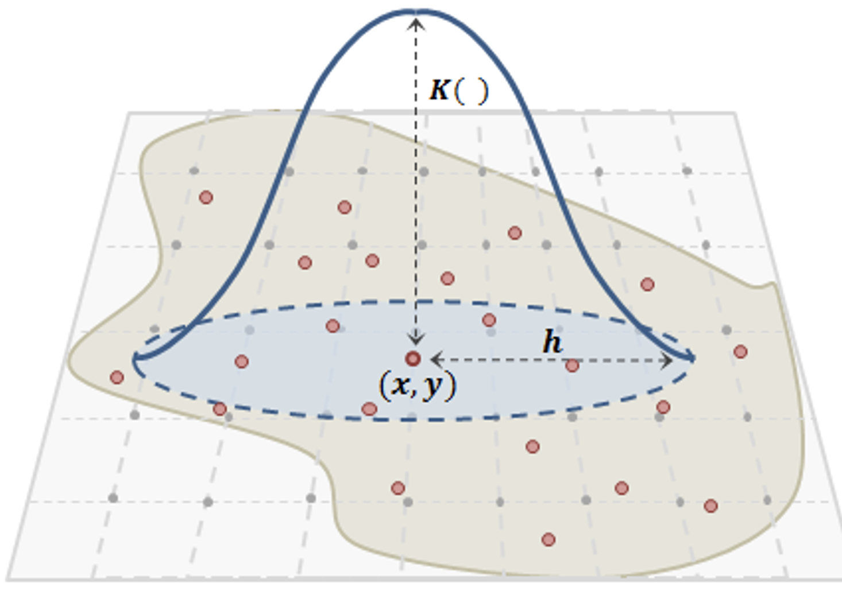

What price, Learnable Kernels?
Explosion of parameters
Discretization in time and space
Time in particular problematic for event-based systems
Learning is inextricably linked to a clock in conventional Deep Learning
$W_{ij}$: red arrows
Copyright © Olivier Coenen, BrainChip Inc.

Slide 16




Research Roadmap for TENNs
One network: many uses
Audio
  Denoising
  Keyword spotting
  Automatic Speech Recognition
  Raw Audio processing
Generative AI
Large Language Models
Intelligent Agents
Primitive Reasoning
LLama 1B Params equiv
Industrial AIoT
Condition Monitoring
Anomaly Detection
Counting
BioMedical
EEG /EKG /EMG
Wearables for health
Activity Monitoring
VR/AR interface
BRAINCHIP | TENN

Slide 17
How well does TENNs work?

Slide 18
TENNs Shows State Of The Art (SOTA) Results across Use Cases
Dynamic Vision Sensor (DVS) – Gesture Recognition – State of the Art Results
Eye tracking: State of the Art Results
Denoising Results: SoTA in size and Performance vs benchmark model 221KB model, PESQ:3.25
Keyword spotting: SoTA in size and performance < 1mw, 50 kb, 97% accuracy (on FP32 model)
Large Language Models
Perplexity is a measure of the ability of an LLM model to predict the next word.
Using the Perplexity benchmark 330M TENNs beats:
  Mamba 713M
  LLAMA 3.2 1B
In other words, we beat models that are 2-2.5X larger while being traded on a fraction of the data.

Slide 19
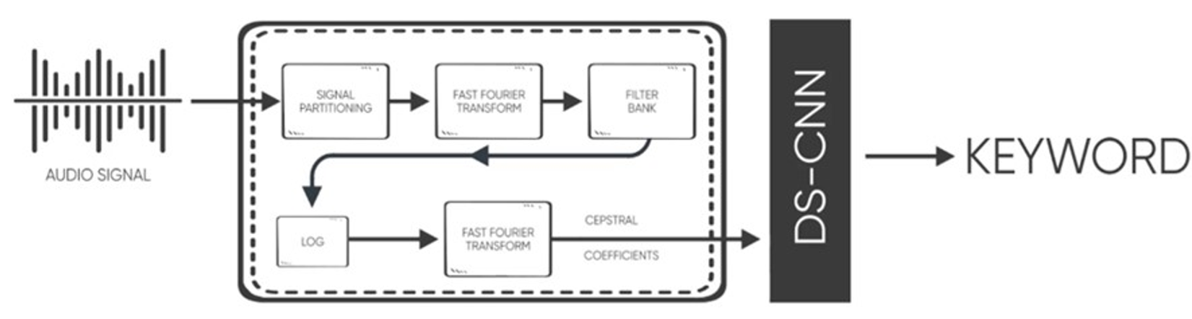

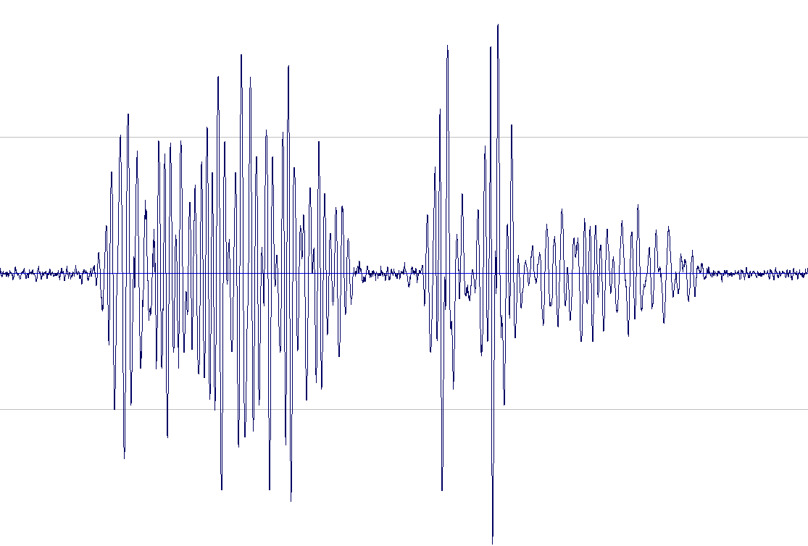
CNN versus TENNs Audio Pipeline
CNN Approach
Recurrent (TENNs) Approach
oldest audio of size
window shift is discarded
oldest audio of size
window shift is discarded
newest audio of size
window shift is included
blue + orange is time window input to MFCC
newest audio of size
time window is included
blue is time window input directly to model
orange is amount of redundant data needed
Main differences
Time window = window shift
No redundant data computed
No MFCC/STFT required
Approved for external release

Slide 20
CNN versus TENNs Audio Pipeline
CNN Approach
Recurrent (TENNs) Approach
Using the DS-CNN model for the Google Speech Commands data set:
Using the TENNs model for the Google Speech Commands data set:
CNN Approach
Time window (ms) | 1000
Window shift (ms) | 2
Redundant data (ms) | 998 ms
MACs/second | 1,268 Million
TENNs Approach
Time window (ms) | 2
Window shift (ms) | 2
Redundant data (ms) | none
MACs/second | 61 Million
Main differences
Time window = window shift
No redundant data computed
No MFCC/STFT required
Approved for external release

Slide 21
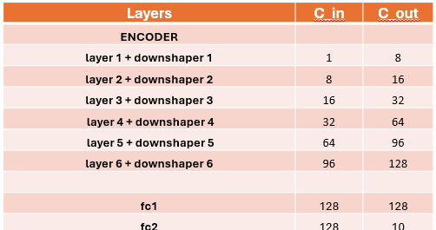
TENNs: KWS Solution
Dataset
Network: TENNs Word Spotting
An Encoder type architecture with TENNs and Fully Connected Layers
The model consists of 6 TENNs layers 2 fully connected layers without skip connections
Metrics
~46K Parameters
~122K MACs/inference at 16 KHz input
8-bit weights/activations, 16-bit state
32 data points at 16KHz equals 2 ms of frame data
Power and latency estimates below assume 300 MHz and 22 nm fabrication technology
  Training: Google Speech Command Dataset
  10 Classes used
  Raw audio input
  No MFCC or STFT used
Results
Mean Power | 0.25 mW
Latency | 2 ms
Total Memory | 50 KB
10-class Accuracy* | 97.02%
*Note: accuracy is for a 32-bit, floating-point version of the model
Approved for external release
Notes:
Add floating point comment – 96.2% accuracy

Slide 22
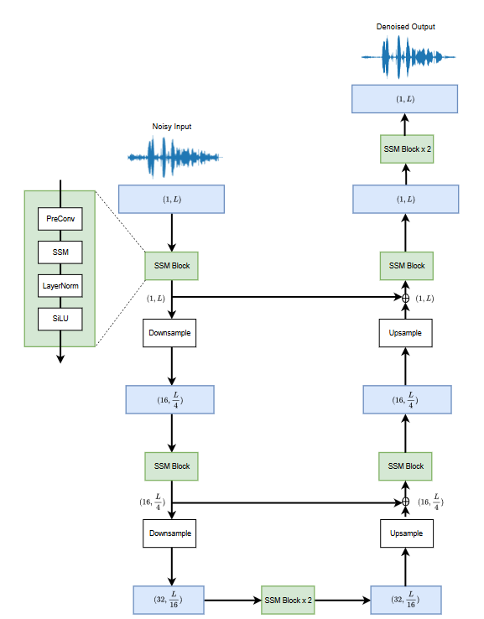
TENNs: Audio Denoising Solution
Network: aTENNuate
A U-Net type architecture with
The model consists of 16 TENNs layers
  Dataset
  Training: Microsoft Deep Noise Separation Challenge 5 (Only English), VCTK+/Librivox and noise files (DNS5 Challenge)
Results
~470K Parameters vs. typical LSTM & GRUs which have 4-5X more parameters
~1.5M MACs/inference at 16 KHz input
Mean Power | 3.2 mW
Latency | 2 ms
Total Memory | 221 KB
PESQ Score* | 3.25
Results
*Note: PESQ score is for a 32-bit, floating-point version of the model
Approved for external release
Notes:
PESQ 3.25

Slide 23

Task: Audio Denoising
Comparison of TENN versus SoTA
Model | Deep Filter Net V1 | TENN | Deep Filter Net V2 | Deep Filter Net V3
PESQ | 2.49 | 3.25 | 2.67 | 2.68
Params (relative to TENN) | 2.98 | 1 | 3.86 | 3.56
MACs (relative to TENN) | 11.7 | 1 | 12.1 | 11.5
Denoised
Noisy samples
TENN (raw audios in and out)
BRAINCHIP | TENN

Slide 24
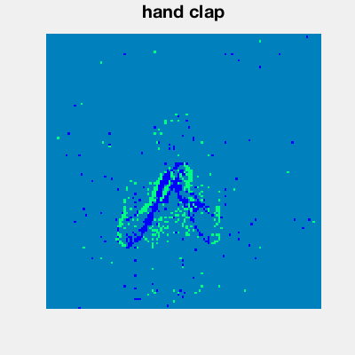
TENN: IBM DVS128 Gesture Dataset Model Comparison
Group | Network | Accuracy (%) | Latency (ms) | MACs (billion) / sec | Parameters
BrainChip | TENN-Confident | 100.0 | 510 | 5.21 | 192 k
Xi’an Jiaotong Univ./ Tsinghua Univ. | TA-SNN | 98.6 | 1500 | - | -
BrainChip | TENN-Fast* | 97.6 | 105 | 3.75 | 192 k
Bosch/Bielefeld Univ. | ANN-Rollouts | 97.0 | 1500 | 10.4 | 500 k
IBM | TrueNorth-CNN | 96.5 | 155** | - | 18 M
BrainChip | Akida-CNN | 95.2 | 200 | 0.12 | 138 k
Intel/National Univ. Singapore | Loihi-Slayer*** | 93.6 | 1450 | - | -
*TENN-Fast indicates a shorter latency than for the TENN-Confident model, mainly due to a smaller network with a shorter processing pipeline. Accuracy reported at indicated latency.
**Latency for TrueNorth: The reported “latency” in the paper is 104 ms. This is the time needed after the start of a gesture for the network to make a prediction (not necessarily correct), so it does not yield their reported accuracy of 96.5%.
***The latency is inferred based on the hyperparameters for simulating the Loihi network provided in the config file of the GitHub repository, as it was not explicitly provided in the Slayer paper.

Slide 25
TASK: DVS Hand Gesture Recognition Accuracy vs Latency
Higher is
better
Lower is better
Notes:
The results for TENN are simulated on a GPU, running in convolution mode and unquantized. On hardware, accuracy drop would be expected after 4-bit quantization and conversion to recurrent mode.
The results shown here are for the DVS128 10-class dataset (excluding the extra class where the subject improvises a random gesture).

Slide 26
Benchmark Comparison with Public LLM Models
Perplexity Benchmark using PILE Dataset
Model | Parameters (w/ Embedding) | Memory Bandwidth⁰ | Perplexity Score¹ (lower is better) | Tokens Trained (Dataset)
Brainchip TENNs | 352M (404M) | 21.1 GB/s | < 6.75 | 60B (Pile uncopyrighted)
Mamba | 713M (791M) | 42.8 GB/s | 6.89 | 300B (Pile copyrighted)
Llama 3.2 | 970M (1.23B) | 58.2 GB/s | 7.17 | ~9T
Training and configuration of dataset used​
  The Pile – 800+GB text corpus dataset​
    To respect copyrighted works, we trained on the smaller uncopyrighted version of the Pile​
    Cleaning to remove Books3, BookCorpus2, OpenSubtitles, YTSubtitles, and OWT2 subsets. Content.
Utilization of raw document information from user manuals
⁰ Assuming 30 tokens / second and FP16 weights/activations
¹ Based upon context length of 2048

Slide 27
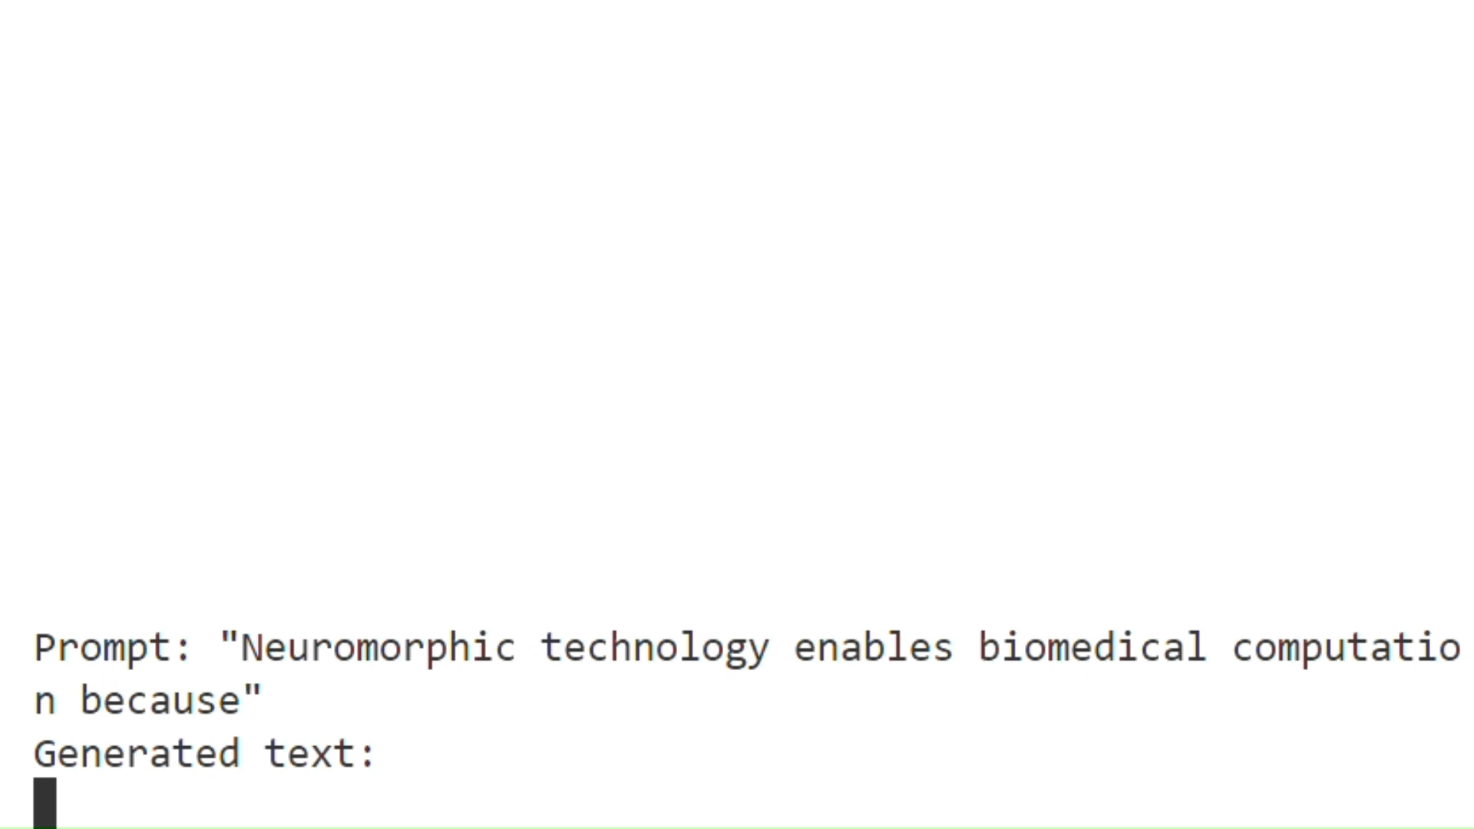
TENNs performs better than networks that a far bigger.
Transformer based network
:
Deep learning is an emerging field of Machine Learning (ML) that aims to learn a model for a data set. This is typically in the form of classifiers, decision trees, models for language models, etc. Here, ML refers to a combination of expert systems and machine learning techniques. Deep Learning has attracted much interest recently due to its breadth and deep features [@Fattah_2019]. One of the key features of deep learning is that it can automatically learn to generalize without information loss. It was
Example of output from 0.4B parameter model
BRAINCHIP | TENN

Slide 28

Is TENNs neuromorphic?
David Marr's three levels of analysis are a framework for understanding information processing systems, such as the human brain:
Computational theory: What is the goal of the computation, and what is the logic of the strategy for carrying it out?
Representation and algorithm: How can the computational theory be implemented? What is the representation for the input and output, and what is the algorithm for the transformation?
Hardware implementation: How can the representation and algorithm be realized physically?

Slide 29
Is TENNs running a Neuromorphic flow machine?
Does TENNs maintain an internal states?
  Maintains internal state. Uses state to accumulate Memories of the past
Can TENNs process infinite streams of data?
Yes
Does TENNs take advantage of Sparsity?
    Yes: It runs on event-based hardware
    No? The recurrent representation seems to squeeze redundancy out
Does it work with events-based sensor directly?
Today no: the examples here, events are collected in frames.
Future: In progress more powerful formulation to work direction with event-based cameras
Does it use spikes?
It can use events
It can also run effectively on any hardware

Slide 30
Key take away
Flow Machines
Algorithms have a huge impact on compute
Sparsity is important
Sparsity tries to get ride of redundancy
TENNs Recurrent mode seems to squeeze out redundancy by other means
TENNs
Traditional Neuromorphic
Animals

Slide 31
Thanks!

